Slide 1
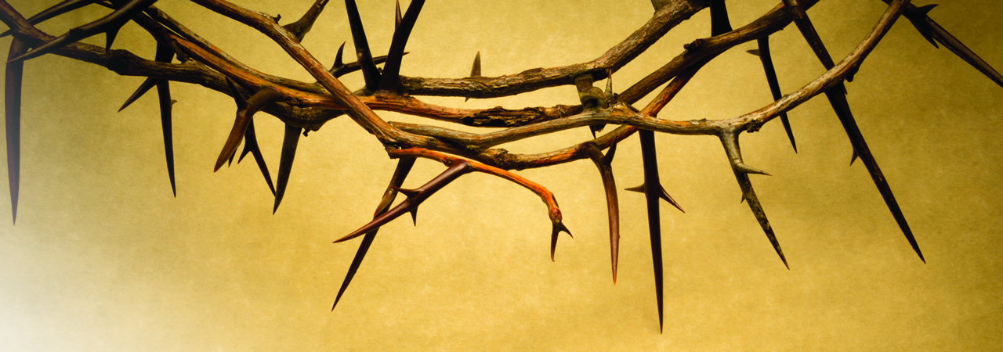
Be Uncompromising
Hebrews
Dr. Rick Griffith • Crossroads International Church Singapore
BibleStudyDownloads.org

Slide 2

Some love running.

Slide 3
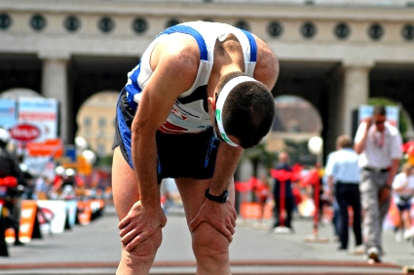
Some quit.

Slide 4
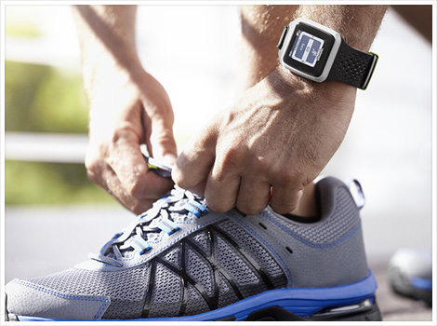
The Christian life is a race

Slide 5
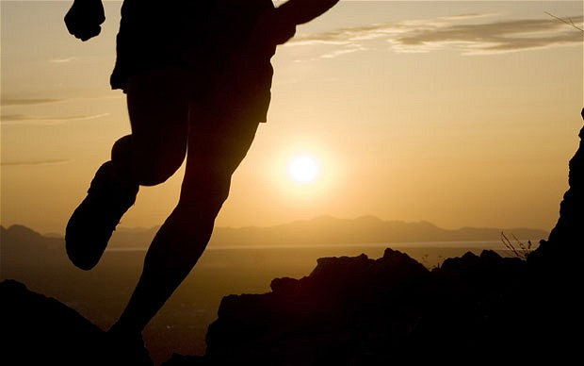
Some are running well but…

Slide 6
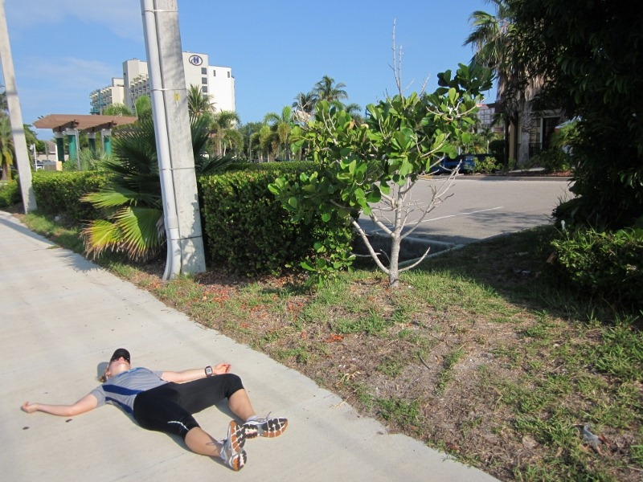
Some quit the Christian race

Slide 7

Why should you be uncompromising in your faith in Jesus?
Notes:
Why should you NOT quit your belief in Christ—no matter how difficult it becomes to serve him?

Slide 8

Press On!
A Study of Hebrews

Slide 9
HEBREWS
256-
257
Author
Recipients
Origin
Destination
UNKNOWN

Slide 10


I think they lived in Israel
256
Rome
Israel

Slide 11

Israel
(AD 67-68)
Jerusalem

Slide 12
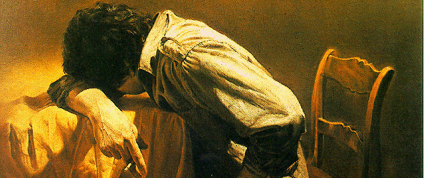
A Jewish Community Under Stress
"You suffered along with those who were thrown into jail, and when all you owned was taken from you, you accepted it with joy. You knew there were better things waiting for you that will last forever" (10:34 NLT).
Notes:
They have a definite history to which the author is acquainted, including their conversion (2:3), ministry to other Christians (6:10), sufferings for the gospel (10:32-34), and present state of spiritual maturity (5:11ff.).
The readers may have been the leaders of a larger community since it is unlikely that the writer would expect the entire church to be teachers (5:12).

Slide 13
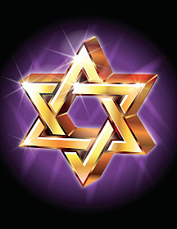
The readers were Jewish Christians
"brothers and sisters who belong to God and are partners with those called to heaven" (3:1)
"…let us hold firmly to what we believe. This High Priest of ours understands…"
(4:14b-15a)
"…dear brothers and sisters, we can boldly enter heaven's Most Holy Place because of the blood of Jesus" (10:19)
"…those early days when you first learned about Christ…you remained faithful even though it meant terrible suffering" (10:32)
Notes:
We also know the readers were Christians. These are clearly believers—why else would he repeatedly call them "brothers and sisters"? These Jews were second-generation (2:1-4) believers (3:1; 4:14b-15a; 10:19, 32; cf. 12:7; 13:1, 20-22) who should have matured beyond their present immature state in Christ (5:11-14)

Slide 14
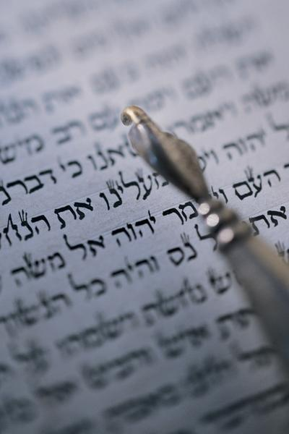
"Should I go back?"
The issue at hand...
"So we must listen very carefully to the truth we have heard, or we may drift away from it"
(2:1 NLT).

Slide 15

Christ is Better

Slide 16
Why should you be uncompromising in your faith in Jesus?
Notes:
Why should you NOT quit your belief in Christ—no matter how difficult it becomes to serve him?

Slide 17
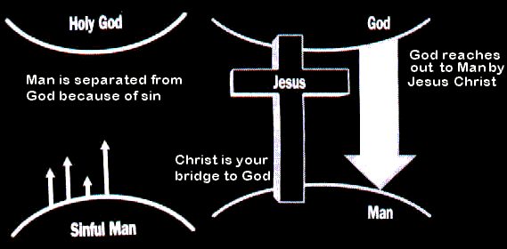
I. Jesus is better than anyone or anything (1:1–10:18).
HOLY GOD
HOLY GOD
We are separated from God because of sin
God reaches down to us in Jesus Christ
Christ is your bridge to God
SINFUL MAN
SINFUL MAN
Notes:
Christ is superior to whoever or whatever you or anyone else can imagine.

Slide 18

Hebrews Book Chart
254
Christ's Superiority Over Judaism as High Priest
Superior in His Person to... |  |  | Superior in His Priestly Work to... |  |  |  |  | Endurance Through Faith
1:1–4:13 |  |  | 4:14–10:18 |  |  |  |  | 10:19–13:25
Prophets | Angels | Moses | Aaron | Melch | Old Cov. | Taber-nacle | Sacri-fices | Will-ful Sin | Models | Endure as Sons | Ethics | Ignoring God | Exhort
1:1-3 | 1:4–2:18 | 3:1–4:13 | 4:14–6:20 | 7 | 8 | 9:1-10 | 9:11–10:18 | 10:19-39 | 11:1–12:3 | 12:4-13 | 12:14-17 | 12:18-29 | 13
Christ's Majesty |  |  | Christ's Ministry |  |  |  |  | Christian's Manifestation
Theology |  |  |  |  |  |  |  | Practice
Unknown Author, Recipients, Origin, and Destination!
AD 67-68

Slide 19
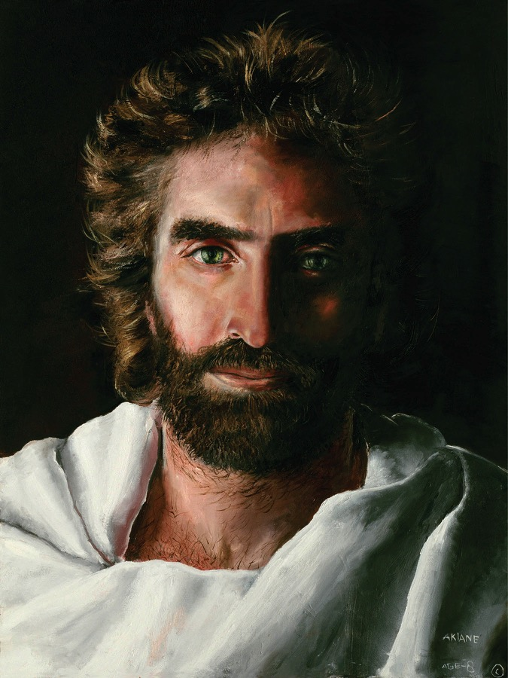
Christ as Superior in His Person (1:1–4:13)

Slide 20
Slides on
Hebrews 1

Slide 21
He is better than the OT prophets, so follow him (1:1-3).

Slide 22
Hebrews 1:1-2
¹ In the past God spoke to our forefathers through the prophets at many times and in various ways,
² but in these last days he has spoken to us by his Son, whom he appointed heir of all things, and through whom he made the universe.

Slide 23
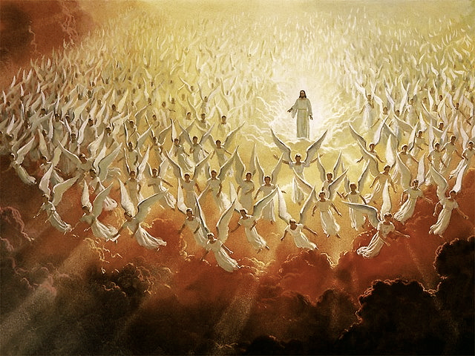
^{Hebrews 1:3}
"The Son is the radiance of God's glory and the exact representation of his being, sustaining all things by his powerful word. After he had provided purification for sins, he sat down at the right hand of the Majesty in heaven."

Slide 24
He is better than the angels as God and man, so respect him as Creator (1:4–2:18).

Slide 25
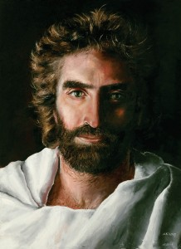
1. Jesus is God worthy of worship (1:4-14).
Notes:
We should worship only God—and Christ qualifies!

Slide 26
"But to the Son he says,
'Your throne, O God,
endures forever and ever.
You rule with a scepter of justice.
⁹You love justice and hate evil.
Therefore, O God, your God has anointed you, pouring out the oil of joy on you more than on anyone else.'"
(1:8-9 NLT).
Notes:
The Father calls Jesus "God" in verses 8-9!

Slide 27
Slides on
Hebrews 2

Slide 28

Warning 1
Abandoning Jesus brings discipline
(2:1-4).
Notes:
Of death…

Slide 29

Hebrews 2:1-2
  "We must pay more careful attention, therefore, to what we have heard, so that we do not drift away.
  For if the message spoken by angels was binding, and every violation and disobedience received its just punishment, how shall we escape if we ignore such a great salvation?"
Notes:
We shouldn’t drift away from holding Christ above angels (2:1).
God disciplined disobedience to his past teaching through angels (2:2).

Slide 30
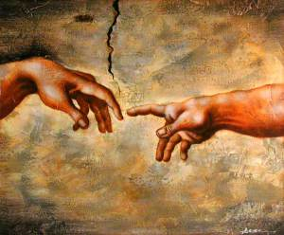
3. Jesus is a man worthy to rule (2:5-18).
Notes:
The original rule was given to the man, Adam—and only a human could fulfill OT prophecies of Messiah’s reign—and Christ qualifies here too

Slide 31
(2:6-8 NLT)
"For in one place the Scriptures say, 'What are mere mortals that you should think about them, or a son of man that you should care for him?
⁷Yet you made them only a little lower than the angels and crowned them with glory and honor.
⁸You gave them authority over all things'"
(2:6-8a NLT).
Notes:
Psalm 8:4-6 promised authority to rule the future world to the man Jesus (2:6-13).
Should we accept as a better translation "what are mere mortals" (2:6 NLT), referring to all men, or is "what is man" (NAU)?
Zane Hodges writes, "A portion of Psalm 8 was now quoted. While the psalm as a whole is often read as a general statement about the role of man in God’s Creation, it is clear in the light of Hebrews 2:5 and the application that follows in verses 8b-9 that the author of Hebrews read it primarily as messianic and eschatological. In doing so he stood well within the New Testament perspective on the Old Testament, a perspective directly traceable to Jesus Himself (cf. Luke 24:25-27, 44-45)" (BKC, 2:784).
I agree with this as verse 8 applies to Jesus—not to mankind: "But we have not yet seen all things put under their authority."
This was not true of Adam, who did have all the earth originally under his authority.
However, while Jesus has all authority now (Matt. 28:19), he does not exercise that full authority over the earth.
In fact, the "son of man" (2:6b) is a title for the ruling Messiah in Daniel 2:13.
Jesus was put under angels while on earth, but that was only temporary so he could go to the cross. Now, "crowned with glory and honor" (2:9b), he is our perfect "ruler" (2:10b).

Slide 32
Slides on
Hebrews 3

Slide 33
He is better than Moses, so don’t forfeit Canaan in the millennial kingdom (3:1–4:13).

Slide 34
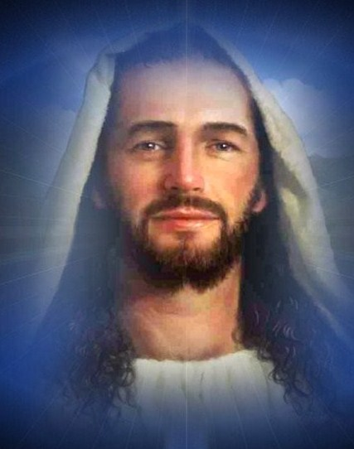
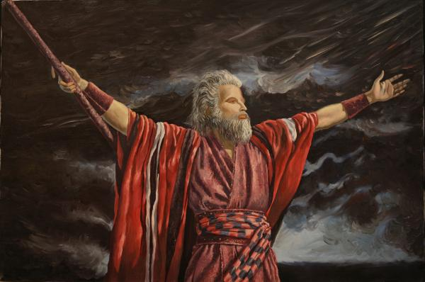
Superior to Moses (3:1–4:7)

Slide 35
Warning 2
Abandoning Jesus forfeits our future rule (3:7-19).
Notes:
Turning our backs on Christ disinherits us from our millennial reign with Christ.

Slide 36

Hebrews 3:12-14 (NLT)
Be careful then, dear brothers and sisters. Make sure that your own hearts are not evil and unbelieving, turning you away from the living God. ¹³You must warn each other every day, while it is still "today," so that none of you will be deceived by sin and hardened against God. ¹⁴For if we are faithful to the end, trusting God just as firmly as when we first believed, we will share in all that belongs to Christ.

Slide 37
Slides on
Hebrews 4

Slide 38
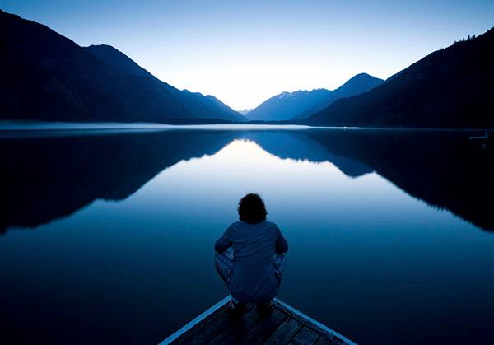
"There remains, then, a Sabbath-rest for the people of God; ¹⁰ for anyone who enters God's rest also rests from his own work, just as God did from his. ¹¹ Let us, therefore, make every effort to enter that rest, so that no one will fall by following their example of disobedience" (4:9-11 NIV)

Slide 39
Two Types of Inheritance
"Now if we are children, then we are heirs—heirs of God and co-heirs with Christ, if indeed we share in his sufferings in order that we may also share in his glory"
(Rom. 8:17 NIV).
= Salvation
= Reward

Slide 40
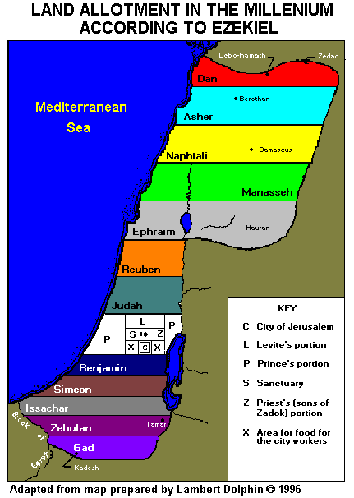
Support for the Future Millennial Rest in Hebrews 4
266i
The context
The land promise
Other Scripture
Extra-biblical references
Hebrews 4:8 time period
An objection rebuffed

Slide 41
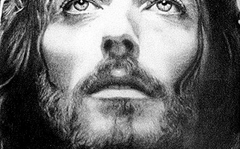
Why follow Jesus as our mediator between God and us?

Slide 42
He is better than Judaism’s high priest, so go to him (4:14–6:20).

Slide 43
Theme
23
Christ's Superiority Over Judaism as High Priest
Hebrews

Slide 44
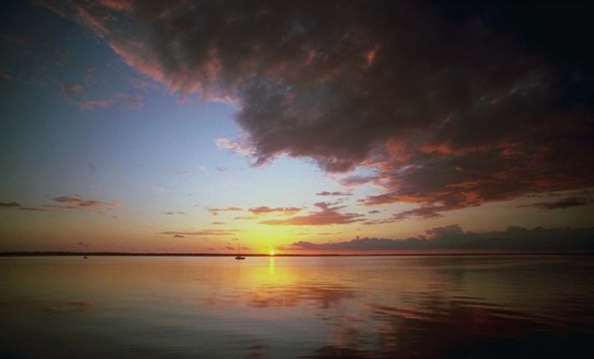
Christ understands suffering
"For we do not have a high priest who is unable to sympathise with our weaknesses, but we have one who has been tempted in every way, just as we are – yet was without sin. Let us then approach the throne of grace with confidence, so that we many receive mercy and find grace to help us in our time of need."
Hebrews 4:15-16

Slide 45
Slides on
Hebrews 5

Slide 46
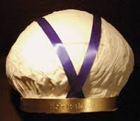
Turban: "Holy to the Lord"

Slide 47
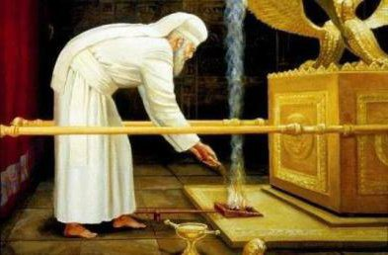
The Day of Atonement (Lev. 16)

Slide 48
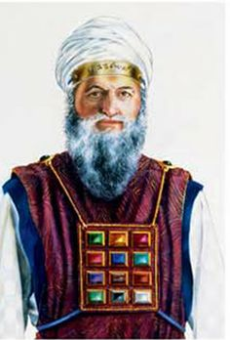
High Priest Requirements
Man (5:1-3)
Called by God (5:4)
Notes:
There were two basic qualifications of the Jewish high priest (5:1-4).
1. He must be a man with human weakness (5:1-3).
2. He must be chosen by God (5:4; see p. 266l for his holy garments).

Slide 49
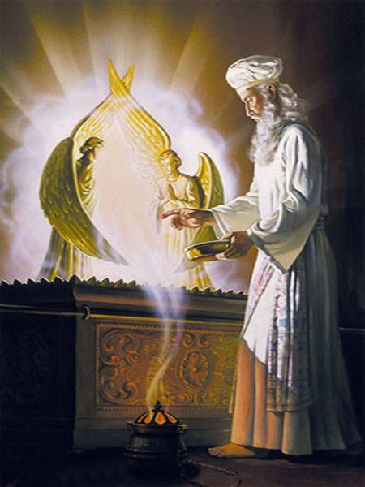
"And no one can become a high priest simply because he wants such an honor. He must be called by God for this work, just as Aaron was"
(5:4 NLT).

Slide 50
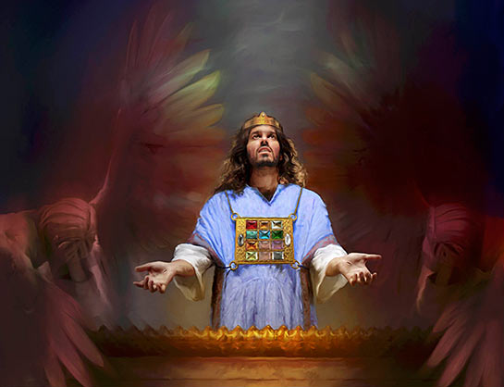
"That is why Christ did not honor himself by assuming he could become High Priest. No, he was chosen by God, who said to him,
'You are my Son.
Today I have become your Father'" (5:5 NLT).

Slide 51
Slides on
Hebrews 6

Slide 52
Warning 3
Rejecting Christ can lead to physical death (6:4-8).
Notes:
Christians who later reject Jesus can die before their time

Slide 53

An Impossibility (Heb. 6:4-6 NLT)
"For it is impossible to bring back to repentance those who were once enlightened—those who have experienced the good things of heaven and shared in the Holy Spirit, ⁵who have tasted the goodness of the word of God and the power of the age to come— ⁶and who then turn away from God. It is impossible to bring such people back to repentance; by rejecting the Son of God, they themselves are nailing him to the cross once again and holding him up to public shame."

Slide 54
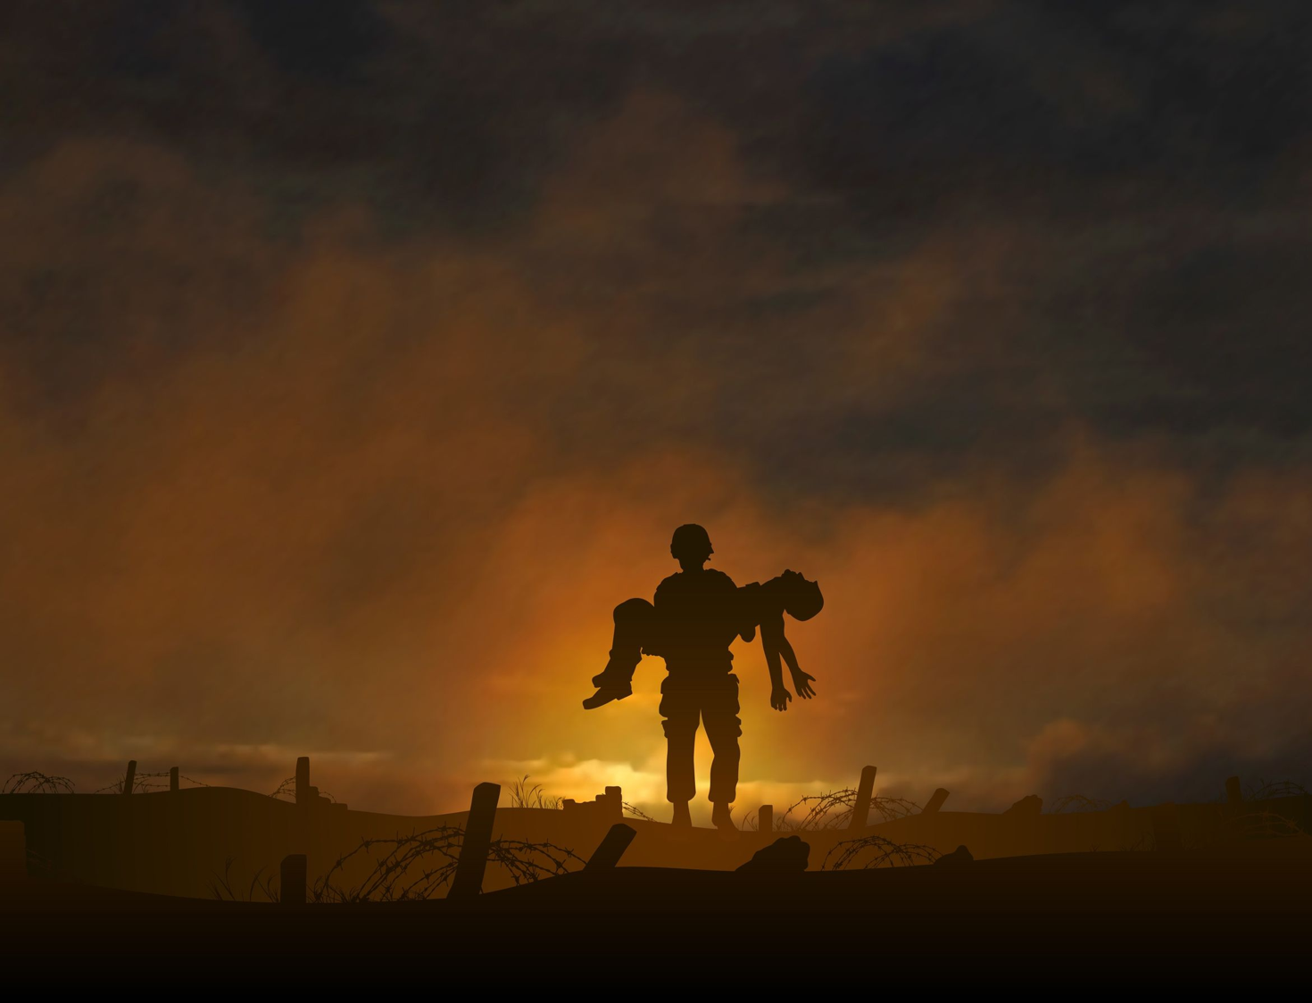
What is the danger in 6:4-8?
A Christian who loses his salvation?
A hypothetical, impossible situation that could never happen?
A profession that really wasn't genuine and thus results in hell?
A Christian who is disqualified for Christian service and will never again return to Christian commitment due to death has the best evidence

Slide 55
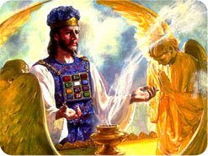
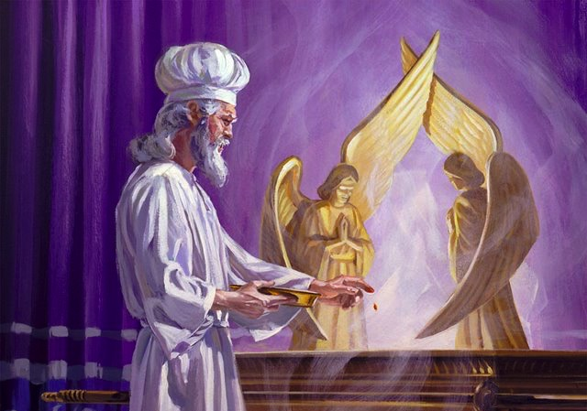
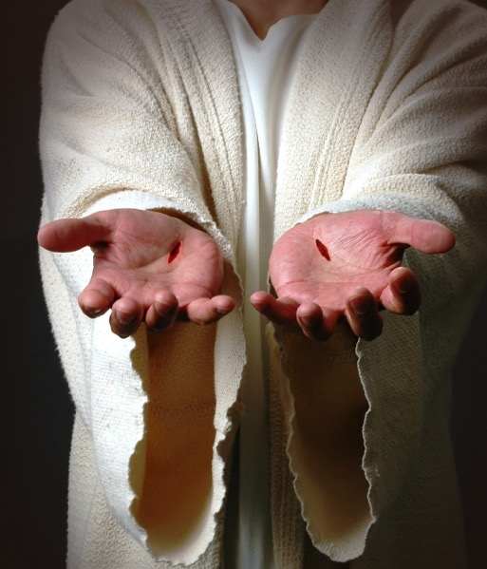
Following a lesser mediator than Jesus can lead to death
Main Idea of 4:14–6:20

Slide 56
Slides on
Hebrews 7

Slide 57
He is better than Abraham and Levi as a Melchizedek Priest, so follow him (Heb 7).

Slide 58
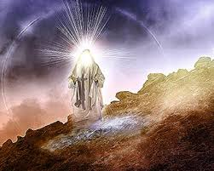
Who really was Melchizedek? (Gen. 14)
"King of righteousness"
King of Jerusalem (cf. Ps. 76:2)
Priest of God Most High
Notes:
Godly—Most Canaanites were evil at this time, but this king is an exception.
Salem is parallel to Zion, or Jerusalem, in Psalm 76:2, "His tabernacle is in Salem; His dwelling place also is in Zion" (NAU)
"Jerusalem" means "city (uru) of Salem (pagan deity)." Not this man!
"Priest of God Most High" can only mean that he functioned as a mediator (priest) between man and God—even Abraham and God!
Here is the first time the word "priest" appears in the Bible.

Slide 59
Christ as Priest, Prophet, & King
266q
Jacob
Levi
10 Other Sons
Judah
Aaron
David
Priest
Prophet
King
Priest from
Melchizedek
(Heb 5:6)
But how could Christ be priest and king?

Slide 60
Slides on
Hebrews 8

Slide 61
He is better than the old covenant in his new covenant, so follow him (Heb 8).

Slide 62
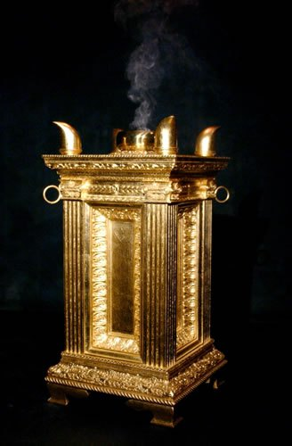
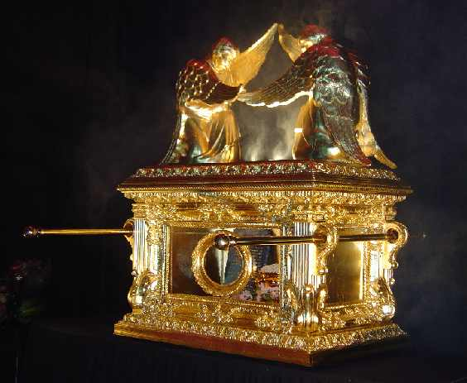
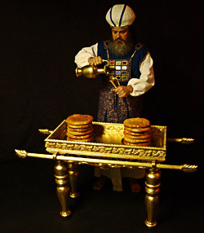
Hebrews 8:6
"But the ministry Jesus has received is as superior to theirs as the covenant of which he is mediator is superior to the old one, and it is founded on better promises."

Slide 63

The New Covenant
266hh
Jeremiah 31:31-34 quoted in Hebrews 8:8-12
³¹"The time is coming," declares the LORD, "when I will make a new covenant with the house of Israel and with the house of Judah.
³²It will not be like the covenant I made with their forefathers when I took them by the hand to lead them out of Egypt, because they broke my covenant, though I was a husband to them," declares the LORD.
³³"This is the covenant I will make with the house of Israel after that time," declares the LORD.

Slide 64
The New Covenant
266hh
Jeremiah 31:31-34 quoted in Hebrews 8:8-12
^{33b} "I will put my law within them, and I will write it on their hearts. And I will be their God, and they shall be my people. And no longer shall each one teach his neighbor and each his brother, saying, 'Know the LORD,' for they shall all know me, from the least of them to the greatest, declares the LORD. For I will forgive their iniquity, and I will remember their sin no more."

Slide 65
Slides on
Hebrews 9

Slide 66
He is better than the tabernacle by his sacrifice, so follow him (9:1–10:18).

Slide 67
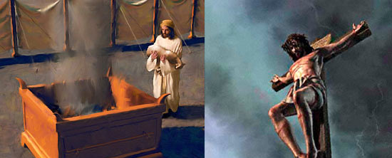
Two questions to consider
What was wrong with the OT sacrifices?
How was Jesus' death better?

Slide 68
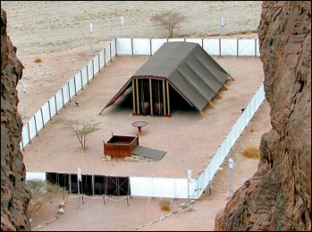
1. Tabernacle sacrifices were temporary (9:1-10).

Slide 69
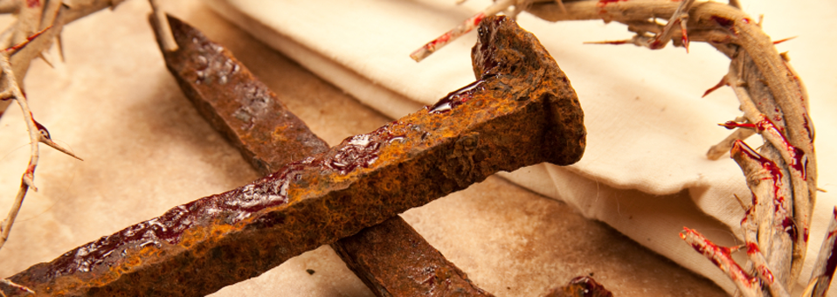
2. Christ's death saves us permanently (9:11–10:18).

Slide 70

Hebrews 9:11
“When Christ came as high priest of the good things that are already here, he went through the greater and more perfect tabernacle that is not man-made, that is to say, not a part of his creation.”

Slide 71
Why should you be uncompromising in your faith in Jesus?
Notes:
Why should you NOT quit your belief in Christ—no matter how difficult it becomes to serve him?

Slide 72
I. Jesus is better than anyone or anything (1:1–10:18).
HOLY GOD
HOLY GOD
We are separated from God because of sin
God reaches down to us in Jesus Christ
Christ is your bridge to God
SINFUL MAN
SINFUL MAN
Notes:
Christ is superior to whoever or whatever you or anyone else can imagine.

Slide 73
Slides on
Hebrews 10

Slide 74

II. Don’t compromise but persevere by faith (10:19–13:25).
Notes:
Don’t shrink back—press on instead!

Slide 75
Stubborn unbelief can even kill you—so press on (10:19-39).

Slide 76
Warning 4
Willful sin can lead to physical death
(10:26-31).
Notes:
Christians with willful sin Jesus can die before their time

Slide 77
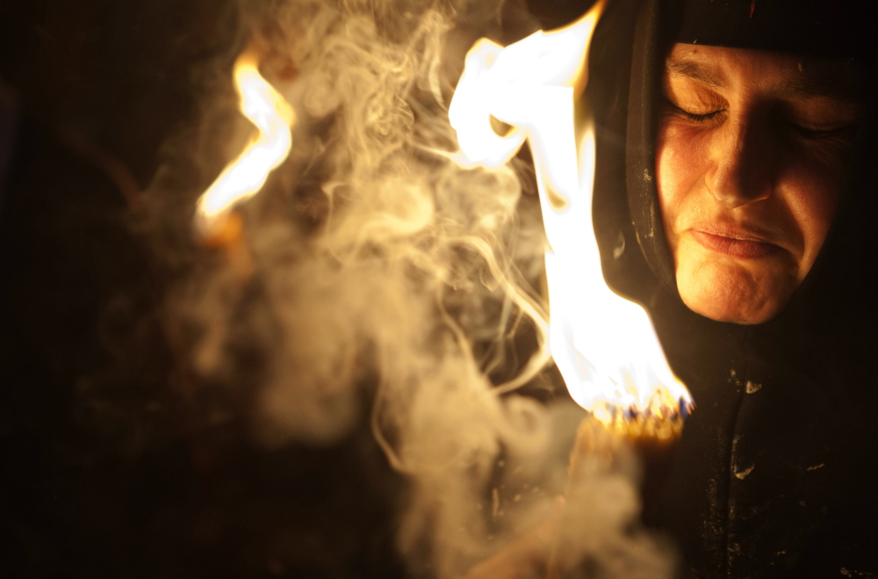
"…if we deliberately continue sinning after we have received knowledge of the truth, there is no longer any sacrifice that will cover these sins. ²⁷There is only the terrible expectation of God's judgment and the raging fire that will consume his enemies"
(10:26-27 NLT).
ARE THESE PEOPLE CHRISTIANS?
YES!

Slide 78

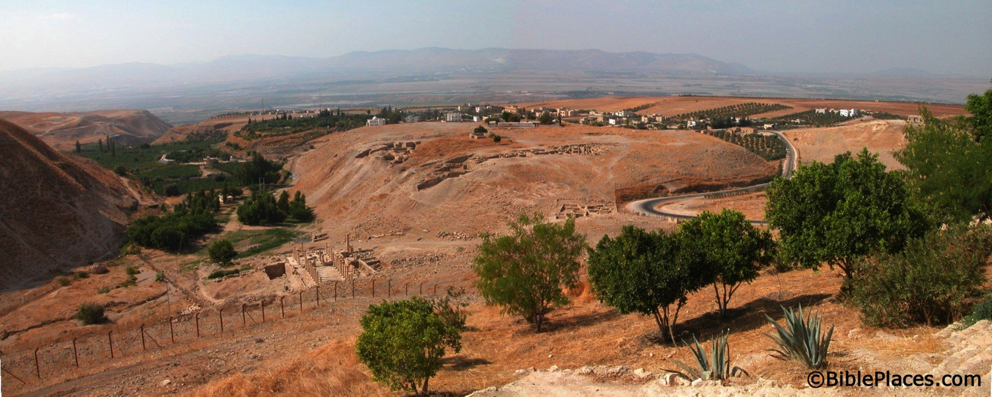
What happened to the Christians in Jerusalem?
A revelation told them to find protection in Pella.
Pella
Jerusalem
Notes:
Todd Bolen: "Pella/Pehel is not mentioned explicitly in the Bible but it was prominent in biblical times. In the days of the judges, it led a rebellion against Egypt which was crushed by Pharaoh Seti I. In NT days, Pella was the site where Christians sought refuge during the Jewish Revolt against the Romans in 66-70 A.D. Eusebius records that the Jewish believers fled here in obedience to a revelation, which some correlate with Jesus' words in Matthew 24:16. This photo views the tell from the east. Several Byzantine churches have been excavated as well as a building believed to be a Late Bronze temple. The Jordan Rift and the mountains of Israel are visible in the background."

Slide 79
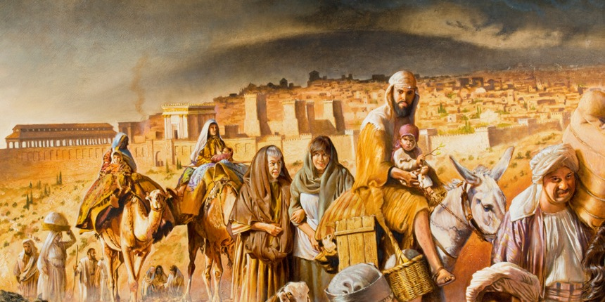
Jerusalem Christians left
Notes:
The believers left Jerusalem before Rome destroyed it in AD 70.

Slide 80
The Fire
"Dear friends, if we deliberately continue sinning after we have received knowledge of the truth, there is no longer any sacrifice that will cover these sins. ²⁷ There is only the terrible expectation of God's judgment and the raging fire that will consume his enemies" (Heb. 10:26-27 NLT).
Hell fire?
No, Jerusalem fire!
Notes:
The fire of 10:27 is not hell fire but Jerusalem fire!

Slide 81
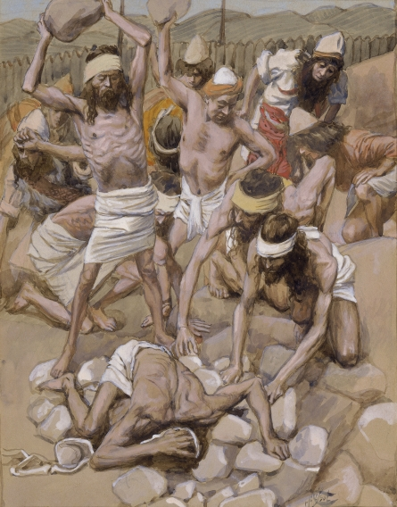
"For anyone who refused to obey the law of Moses was put to death without mercy on the testimony of two or three witnesses"
(Hebrews 10:28; cf. Num. 15:30-36 NLT).
Notes:
Numbers 15:22-29 specifies sin offerings for Jewish believers who sinned unintentionally. But what should Israel do when God specifically told them not to work on the Sabbath on the penalty of death?
• Numbers 15:30-36 specifies death for capital crimes. Here was the case of intentional sin where a man caught in deliberate sin was stoned.

Slide 82
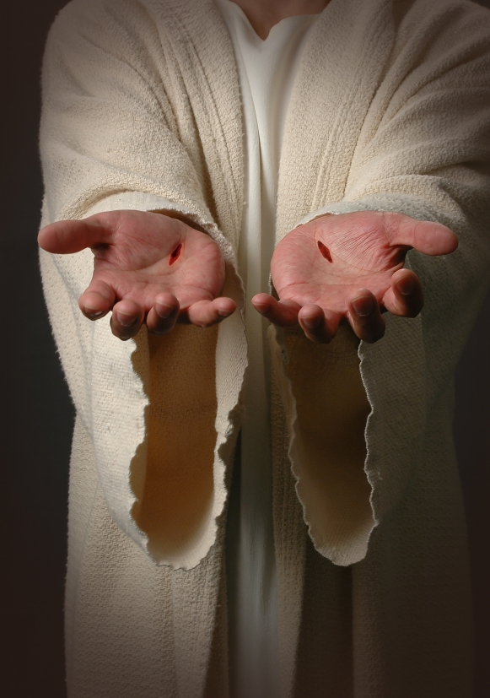
"Just think how much worse the punishment will be for those who have trampled on the Son of God, and have treated the blood of the covenant, which made us holy, as if it were common and unholy, and have insulted and disdained the Holy Spirit who brings God's mercy to us"
(Hebrews 10:29 NLT).
Notes:
Isn’t picking up sticks far less severe than a believer rejecting our Risen Lord Jesus?

Slide 83
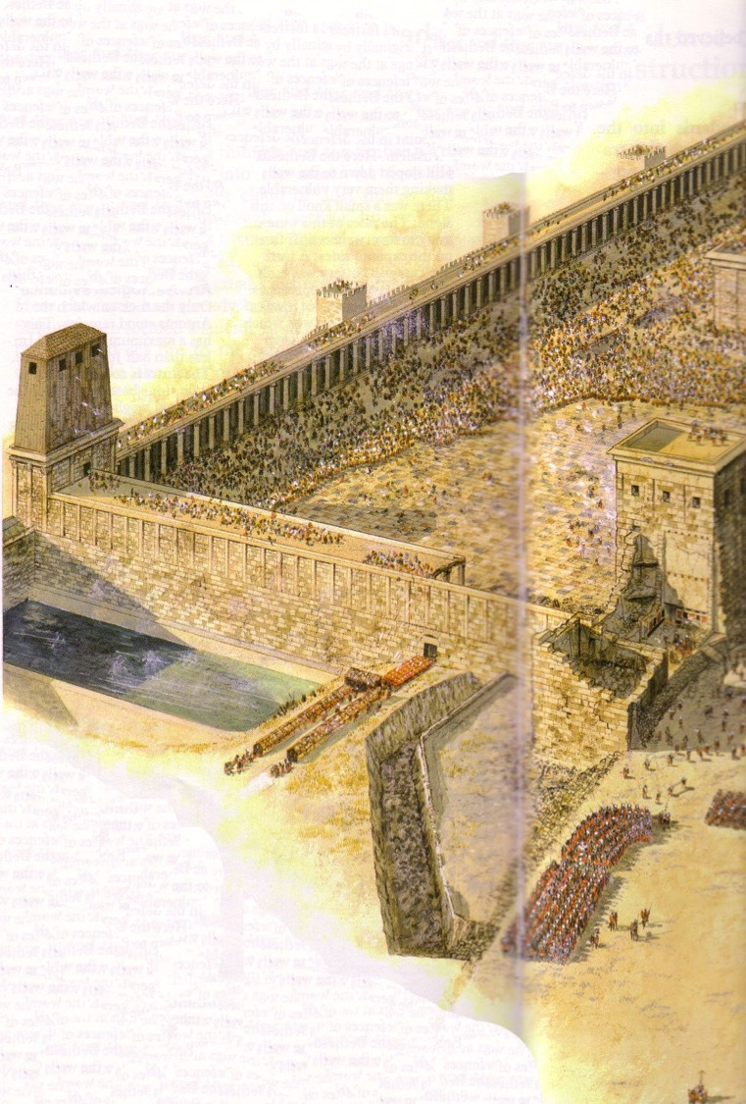
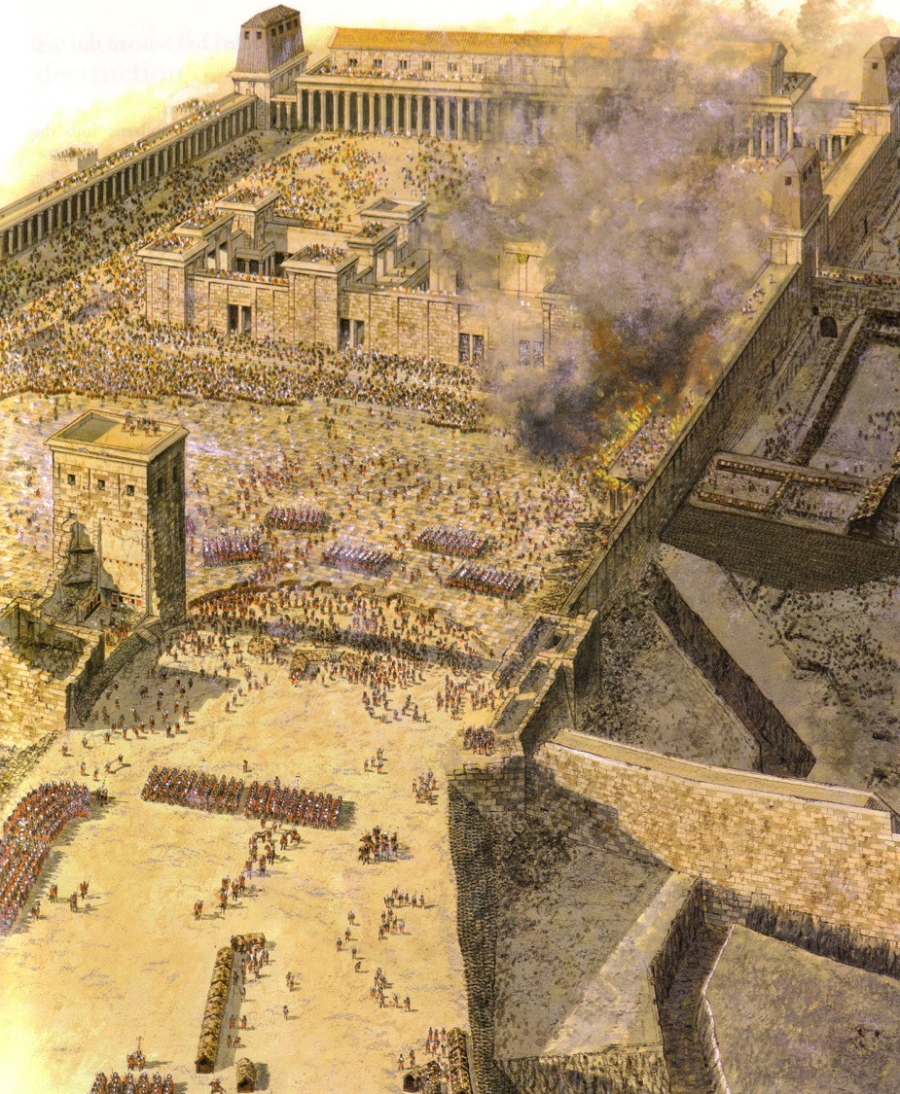
Antonia Fortress Leveled

Slide 84
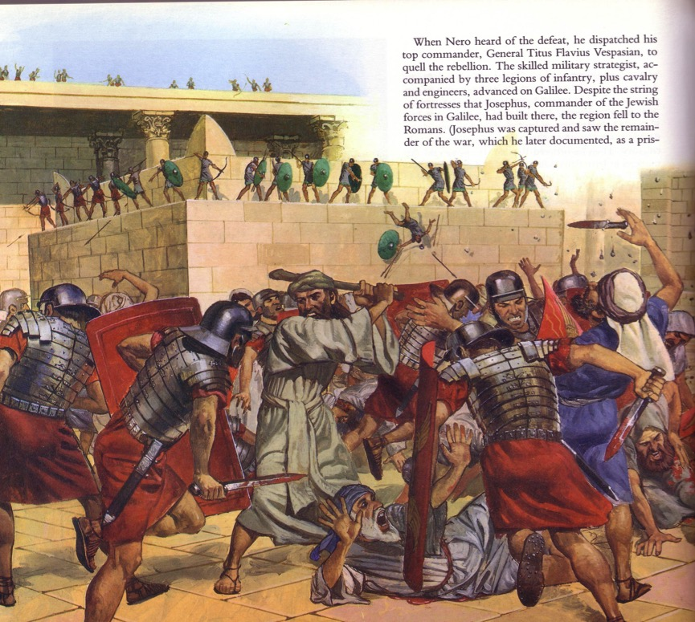
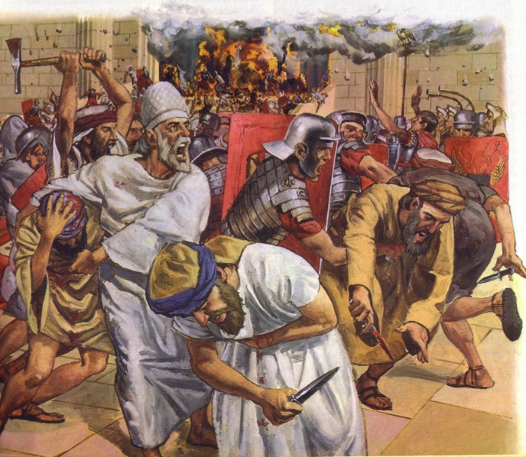
The Temple Assault

Slide 85
Hebrews 8:13
"By calling this covenant 'new,'
he has made the first one obsolete; and what is obsolete and aging will soon disappear."
Obsolete
AD 33
Hebrews Written
AD 67-68
Disappeared
AD 70

Slide 86
Slides on
Hebrews 11

Slide 87
Others faithfully endured before you to give you examples—so press on (11:1–12:3).

Slide 88


HALL OF FAME

Slide 89
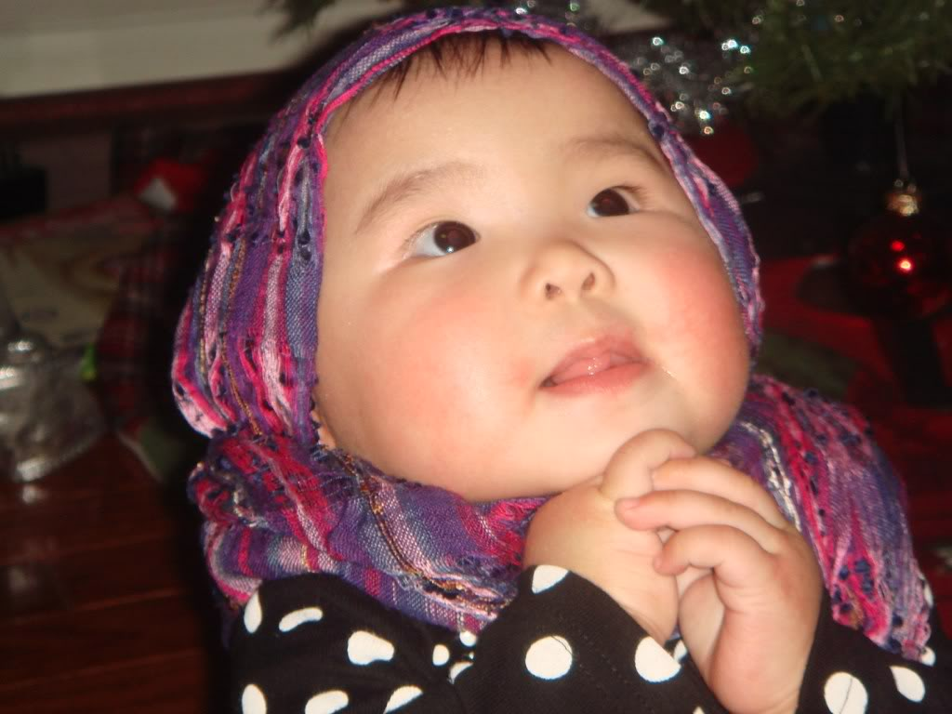
"By Faith…" (Hebrews 11)
"Faith is the confidence that what we hope for will actually happen; it gives us assurance about things we cannot see" (Heb. 11:1 NLT)
Notes:
Definition: Faith sees the unseen (11:1).

Slide 90
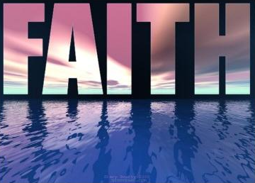
Hebrews 11:6
"And it is impossible to please God without faith. Anyone who wants to come to him must believe that God exists and that he rewards those who sincerely seek him"
(Hebrews 11:6 NLT)

Slide 91
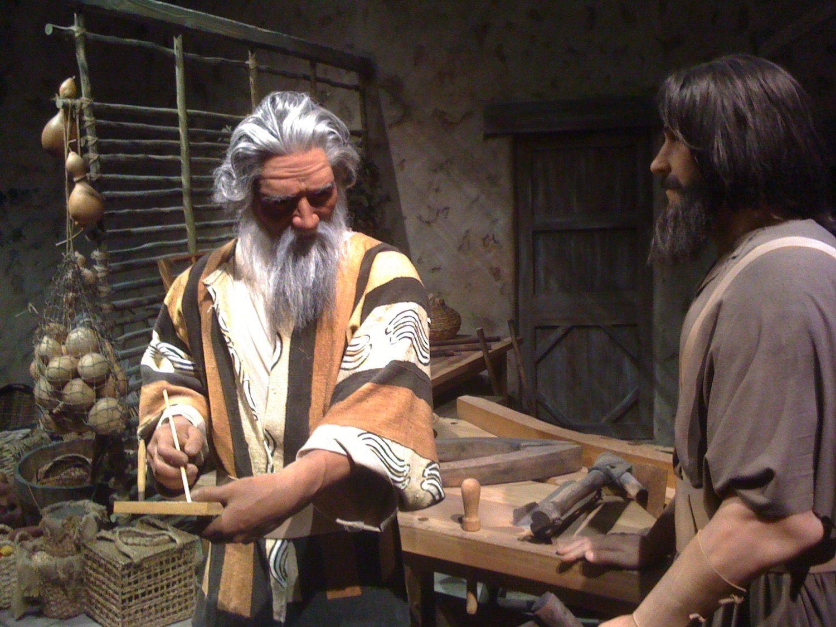
"By Faith…" (Hebrews 11)
"It was by faith that Noah built a large boat to save his family from the flood. He obeyed God, who warned him about things that had never happened before. By his faith Noah condemned the rest of the world, and he received the righteousness that comes by faith"
(Hebrews 11:7 NLT)

Slide 92
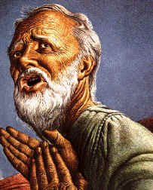
"By Faith…" (Hebrews 11)
"It was by faith that Abraham obeyed when God called him to leave home and go to another land that God would give him as his inheritance. He went without knowing where he was going"
(Hebrews 11:8 NLT)

Slide 93
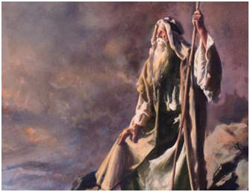
Moses and the conquest generation acted with certainty on an unseen hope (Hebrews 11:23-31).

Slide 94
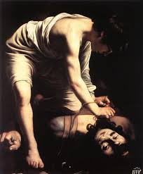




People of many generations acted with certainty on an unseen hope (Hebrews 11:32-38).

Slide 95

"By faith these people overthrew kingdoms, ruled with justice, and received what God had promised them. They shut the mouths of lions…"
(Hebrews 11:33 NLT).

Slide 96


"Some died by stoning, some were sawed in half, and others were killed with the sword"
(Hebrews 11:37a NLT).

Slide 97
Slides on
Hebrews 12

Slide 98

KEY VERSE
  Hebrews 12:1-2
  "Therefore, since we are surrounded by such a great cloud of witnesses, let us throw off everything that hinders and the sin that so easily entangles, and let us run with perseverance the race marked out for us.
  Let us fix our eyes on Jesus, the author and perfecter of our faith, who for the joy set before him, endured the cross, scorning its shame and sat down at the right hand of the throne of God."

Slide 99
God’s discipline grows righteousness, confidence and relationships—so press on
(12:4-17).

Slide 100

Loving Discipline
(Hebrews 12:5-7 NLT)
"My child, don't make light of the LORD's discipline, and don't give up when he corrects you.
⁶For the LORD disciplines those he loves,
and he punishes each one he accepts as his child."

Slide 101
Ignoring God invites his loving discipline of you—so press on (12:18-29).

Slide 102
Warning 5
Refusing God has consequences
(12:25-29).
Notes:
Ignore the Lord and you will experience his discipline rather than his grace.

Slide 103
Slides on
Hebrews 13

Slide 104
Many practical ways to serve God exist for you—so press on (Heb 13).

Slide 105


Slide 106


"Don't love money; be satisfied with what you have. For God has said,
'I will never fail you. I will never abandon you'"
(Hebrews 13:5 NLT).
Notes:
"Let's look at just a few facts: Americans have 3 times more space than they did 50 years ago. Yet there's a booming $22 Billion dollar/year Storage Space industry. Which means we have, on average, more than 3 times the stuff, still need extra storage and are willing to pay extra for it. At the same time, credit card debt levels and, not surprisingly, stress levels have gone way up.
Also not surprisingly, happiness levels have flatlined in the last 50 years. Human greed was, perhaps, more glaringly visible than ever before, as the direct source of the last Global Recession. Has humanity looked at that and drastically changed it's MO? Have we looked at ourselves, and wondered how much of that stuff might have trickled into the Church?"
Money Talk – 4 Ways To Stop Loving Money
06/02/2014
http://austinchristian.org/money-talk-4-ways-to-stop-loving-money/

Slide 107


Application: "Leave Jerusalem"
"So also Jesus suffered and died outside the city gates to make his people holy by means of his own blood"
(Heb. 13:12 NLT)
¹³ So let us go out to him, outside the camp, and bear the disgrace he bore"
(Heb. 13:13 NLT)
Leen & Kathleen Ritmeyer, "Akeldama: Potter's Field or High Priest's Tomb?" BAR 20 (Nov/Dec 94): 34
Notes:
The application to leave Jerusalem is in Hebrews 13.

Slide 108

Now may the God of peace, who through the blood of the eternal covenant brought back from the dead our Lord Jesus, that great Shepherd of the sheep, ²¹ equip you with everything good for doing his will, and may he work in us what is pleasing to him, through Jesus Christ, to whom be glory forever and ever. Amen.
Hebrews 13:20-21

Slide 109
Why should you be uncompromising in your faith in Jesus?
Notes:
Why should you NOT quit your belief in Christ—no matter how difficult it becomes to serve him?

Slide 110
I. Jesus is better than anyone or anything (1:1–10:18).
HOLY GOD
HOLY GOD
We are separated from God because of sin
God reaches down to us in Jesus Christ
Christ is your bridge to God
SINFUL MAN
SINFUL MAN
Notes:
Christ is superior to whoever or whatever you or anyone else can imagine.

Slide 111
II. Don’t compromise but persevere by faith (10:19–13:25).
Notes:
Don’t shrink back—press on instead!

Slide 112

Main Idea
Jesus is your “go-to” mediator between you and God
Hebrews
Notes:
Christ is the only high priest you have to represent the sinful you to the sinless God.

Slide 113

Where do you need to press on?

Slide 114
Black

Slide 115


NT Preaching link at BibleStudyDownloads.org
Get this presentation for free!
Notes:
NT Survey (ns)

